Slide 1



KBTG x MeowCode
Say “Hello”
Git & GitHub
Jetsukda Janthornthao
AI Engineer @ Ztrus
x

Slide 2


What is version control?
Local version control systems
Centralized version control systems
Distributed version control systems
What is Git?
Git installation
Git visualization
Introduction to Git
and other version control

Slide 3

What is version control?
Version Control Systems (VCS)
keeps records changes to a file or set of files
keeps records changes to a file or set of files
Git, Subversion, Mercurial, CVS
https://medium.com/@deryacortuk/version-control-software-comparison-git-mercurial-cvs-svn-21b2a71226e4

Slide 4
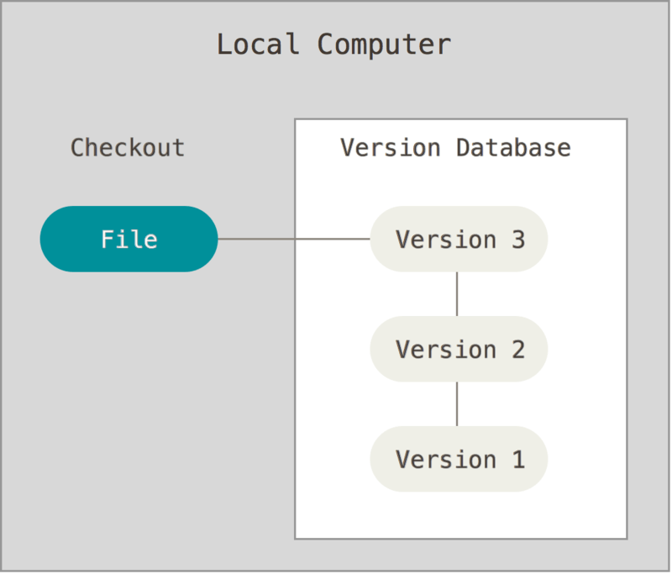
Local version control systems
https://git-scm.com/book/en/v2/Getting-Started-About-Version-Control

Slide 5
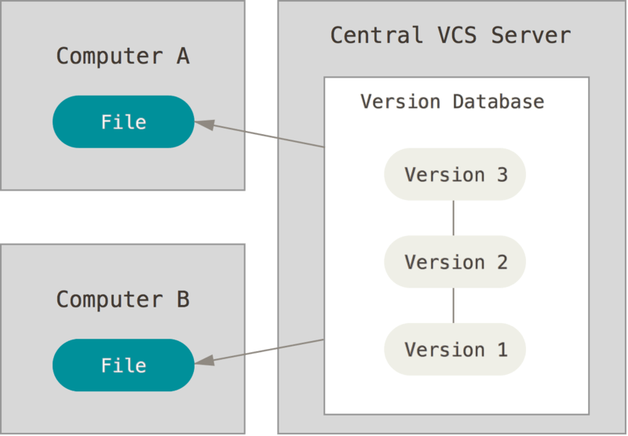
Centralized version control systems
https://git-scm.com/book/en/v2/Getting-Started-About-Version-Control

Slide 6
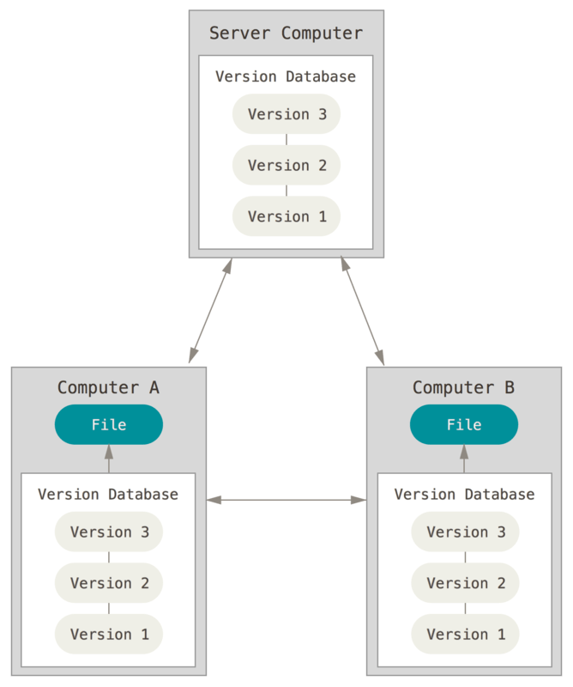
Distributed version control
https://git-scm.com/book/en/v2/Getting-Started-About-Version-Control

Slide 7
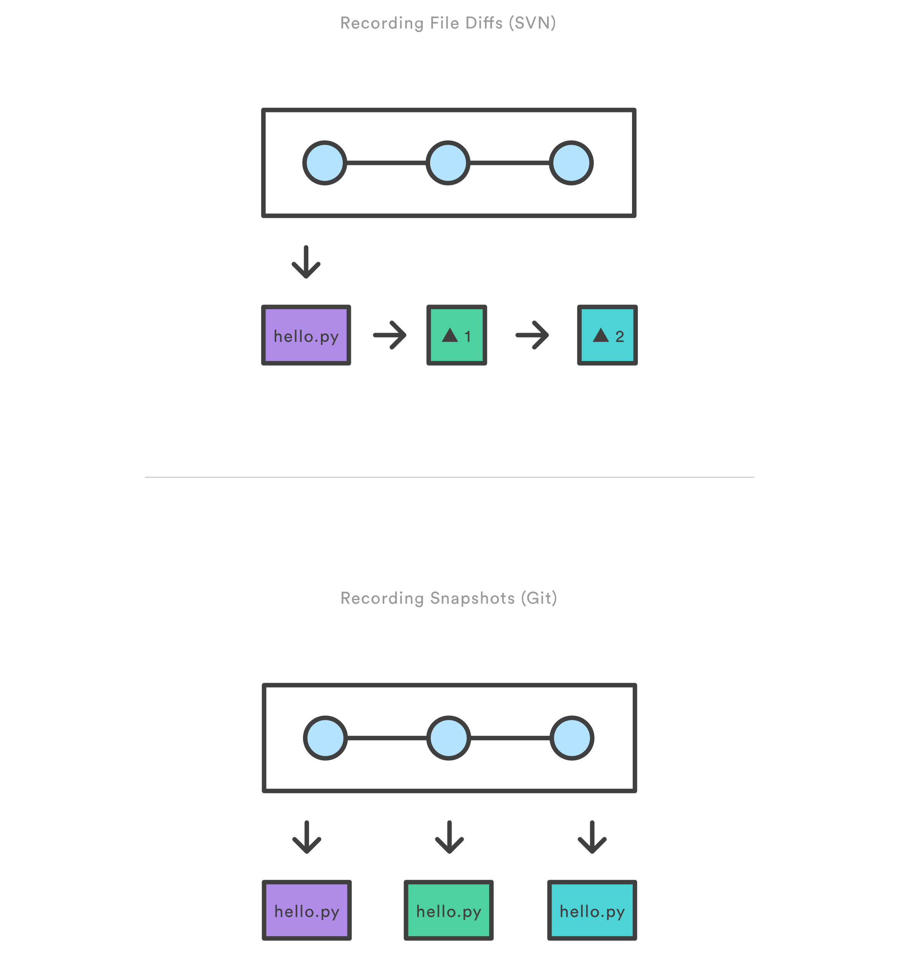
Subversion(SVN) to Git
Snapshots, not differences
https://www.atlassian.com/git/tutorials/saving-changes/git-commit

Slide 8

Why Git for your organization
Developers
Marketing
Product Management
Designers
Customer Support
Human Resources
Anyone managing a budget
https://www.atlassian.com/git/tutorials/why-git

Slide 9
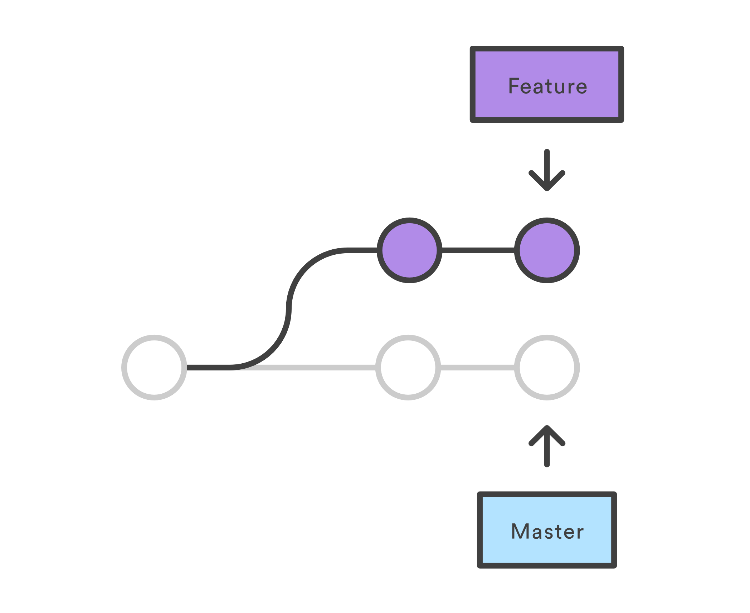
Git for developers
Feature Branch Workflow
https://www.atlassian.com/git/tutorials/why-git

Slide 10
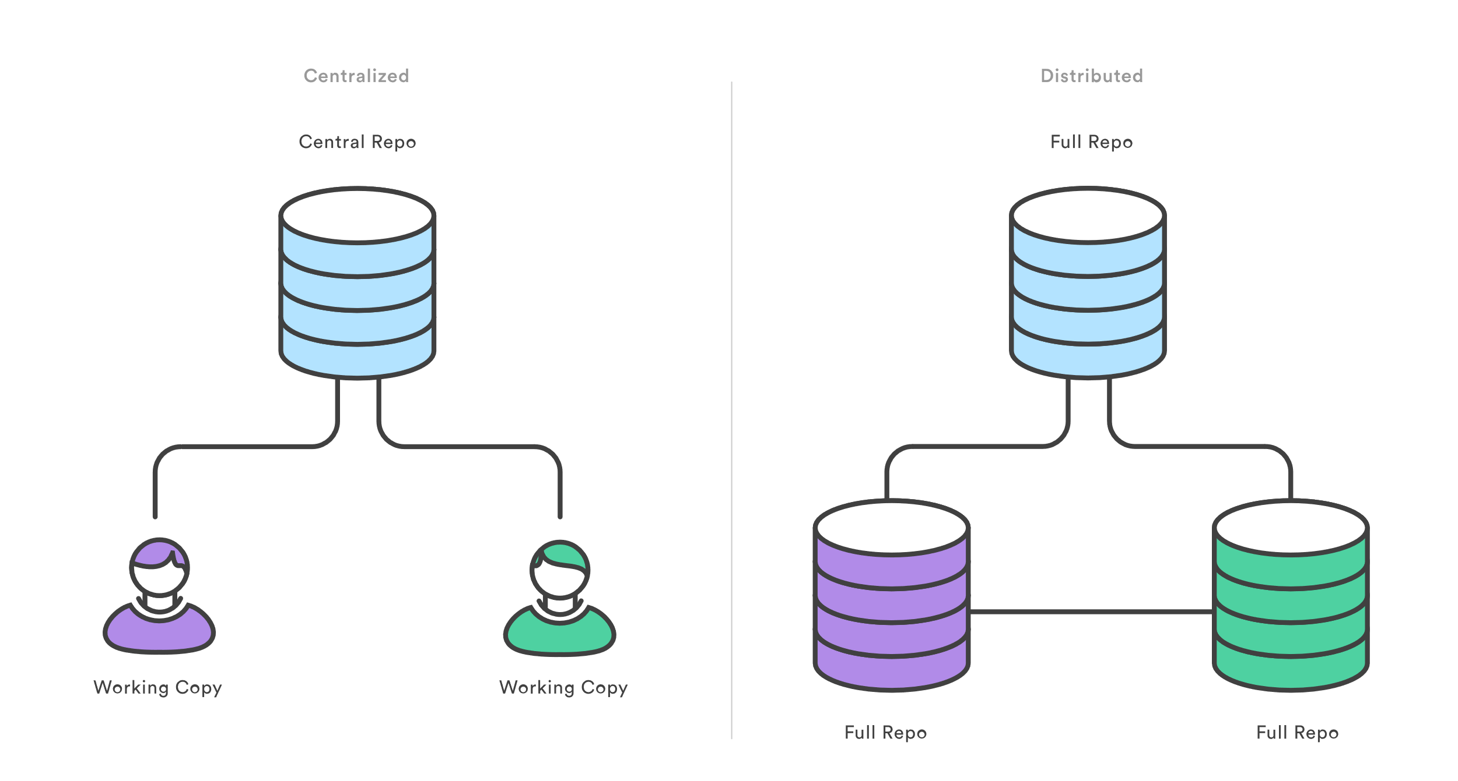
Git for developers
Distributed Development
https://www.atlassian.com/git/tutorials/why-git

Slide 11
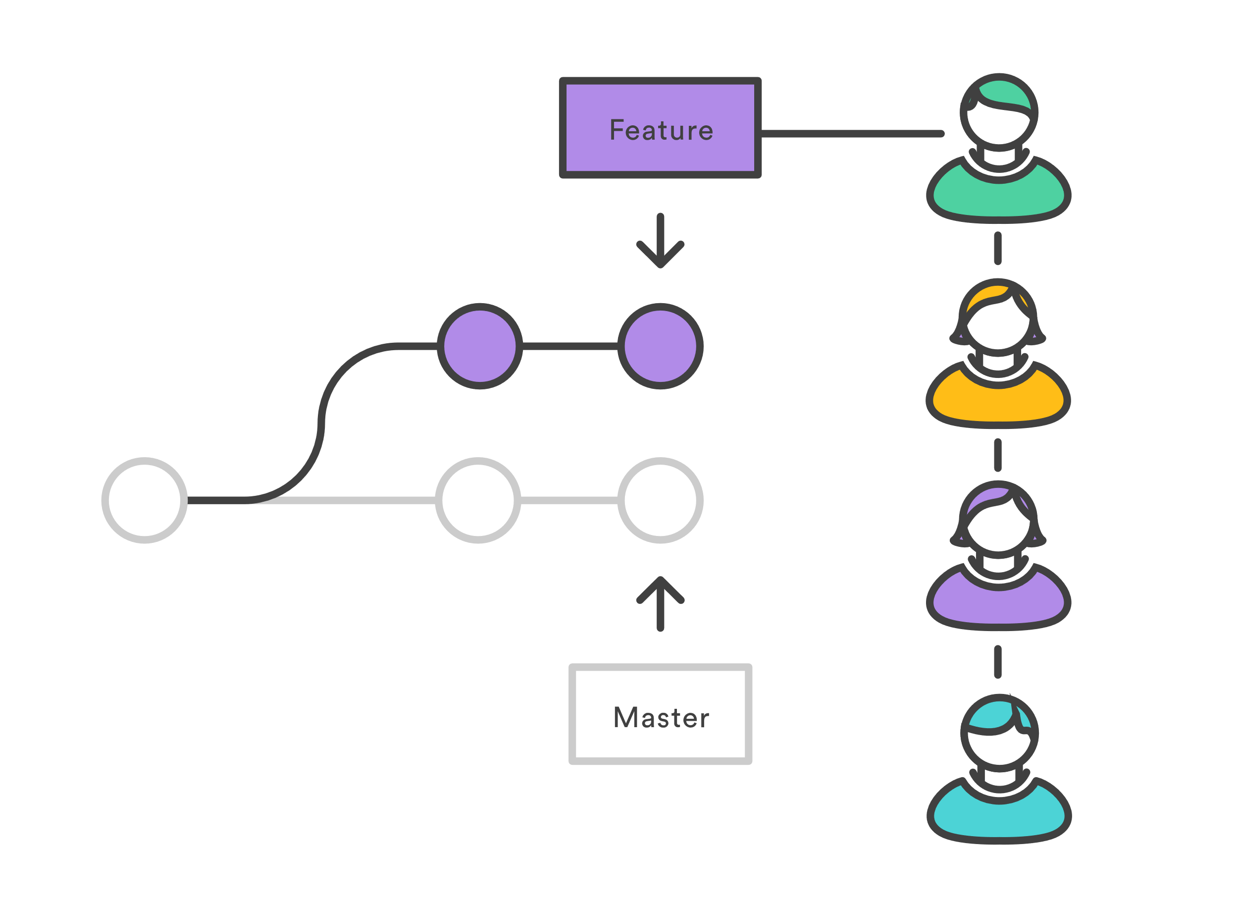
Git for developers
Pull Requests
https://www.atlassian.com/git/tutorials/why-git

Slide 12
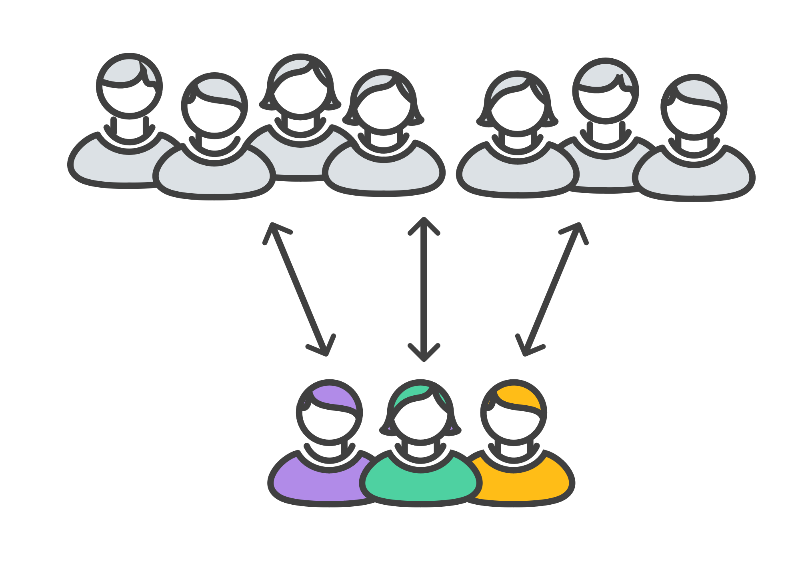
Git for developers
Community
Community
https://www.atlassian.com/git/tutorials/why-git

Slide 13
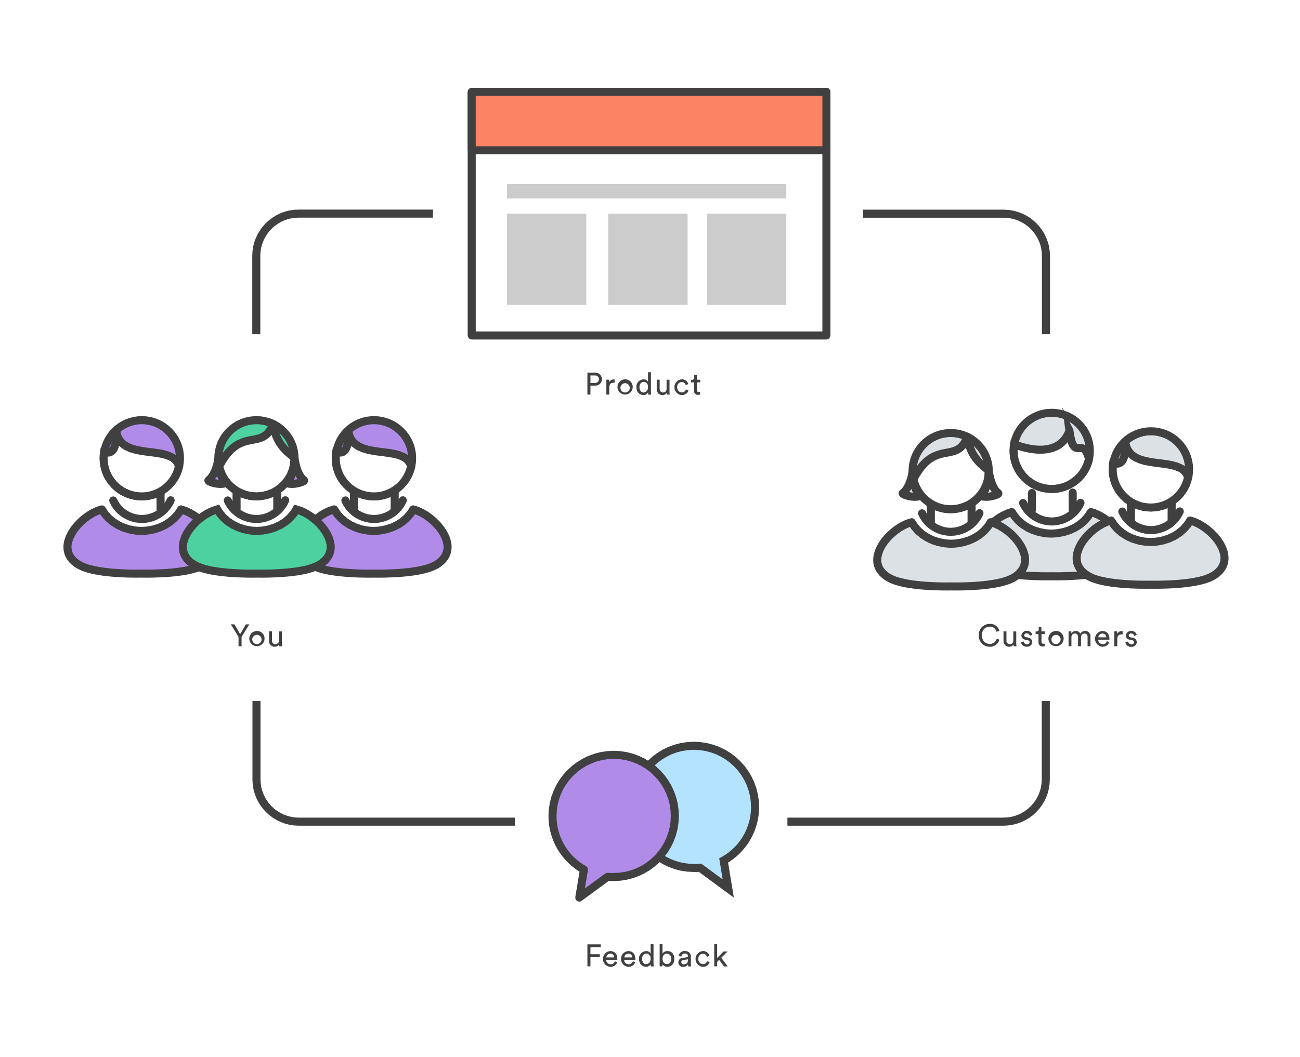
Git for developers
Faster Release Cycle
https://www.atlassian.com/git/tutorials/why-git

Slide 14
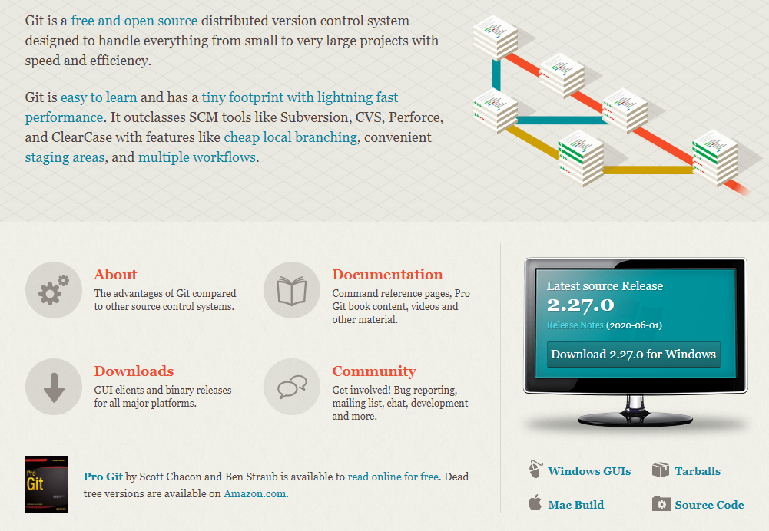
Install Git
https://git-scm.com/

Slide 15



Git Visualization
https://www.gitkraken.com/git-client
https://desktop.github.com/
https://www.sourcetreeapp.com/

Slide 16
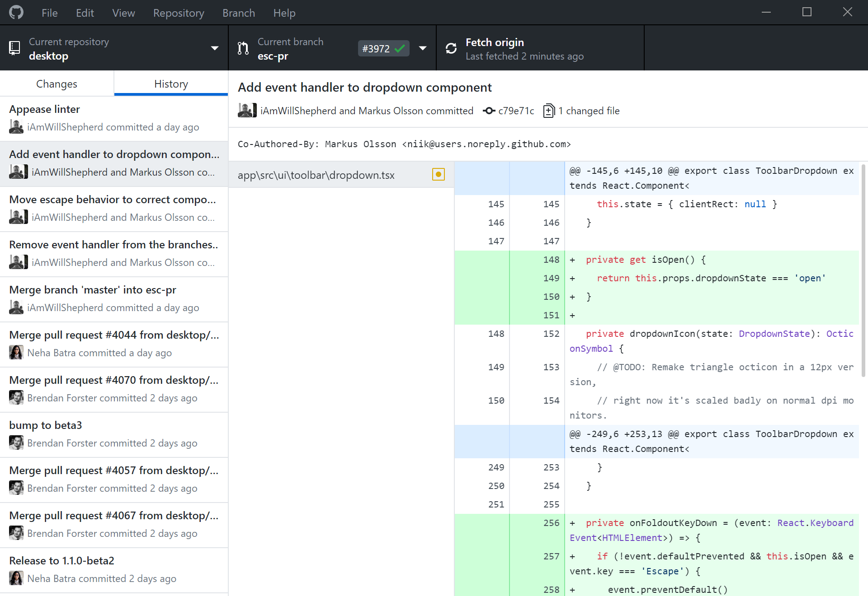

GitHub Desktop
https://desktop.github.com/

Slide 17
Git Workflow
Git Terminology
The Staging Area
Git Environment Setup
Git command line
Git Basics 101

Slide 18
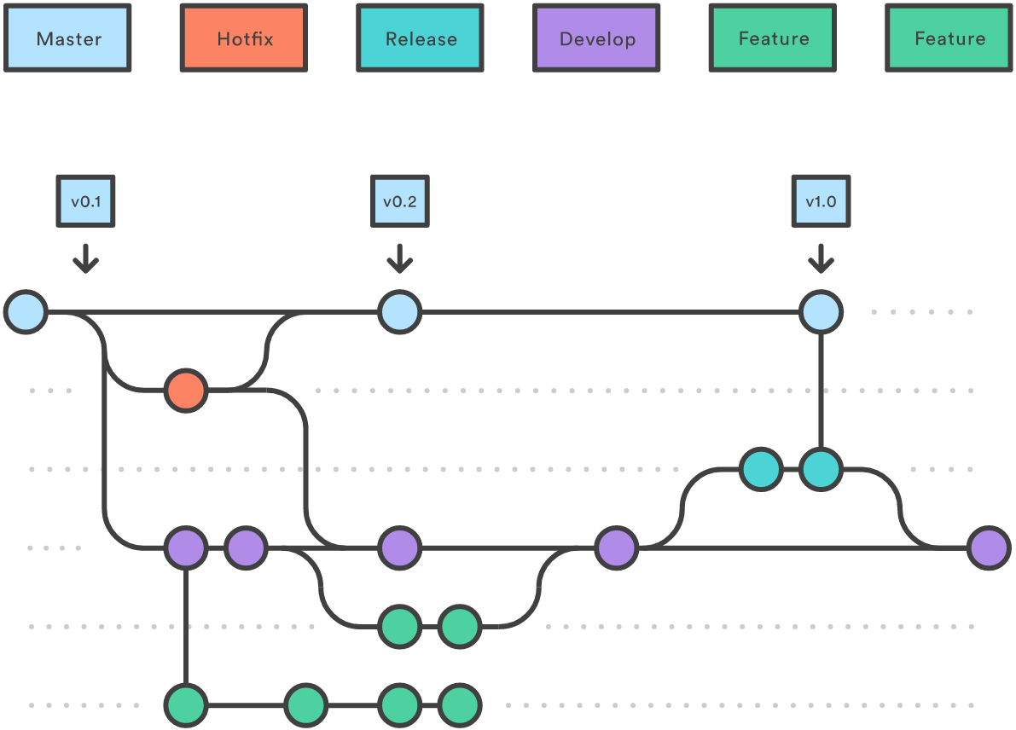
Git Branches: overview
Main Branches
Support Branches

Slide 19
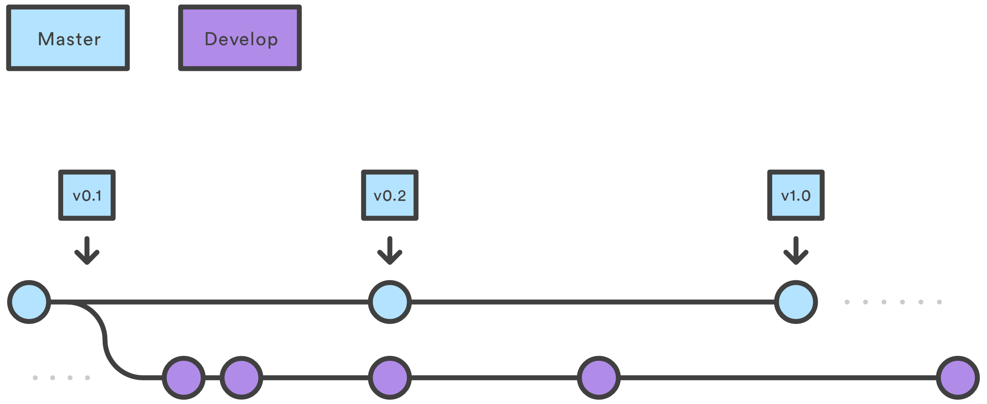
Git Branches: Develop and Master Branches

Slide 20
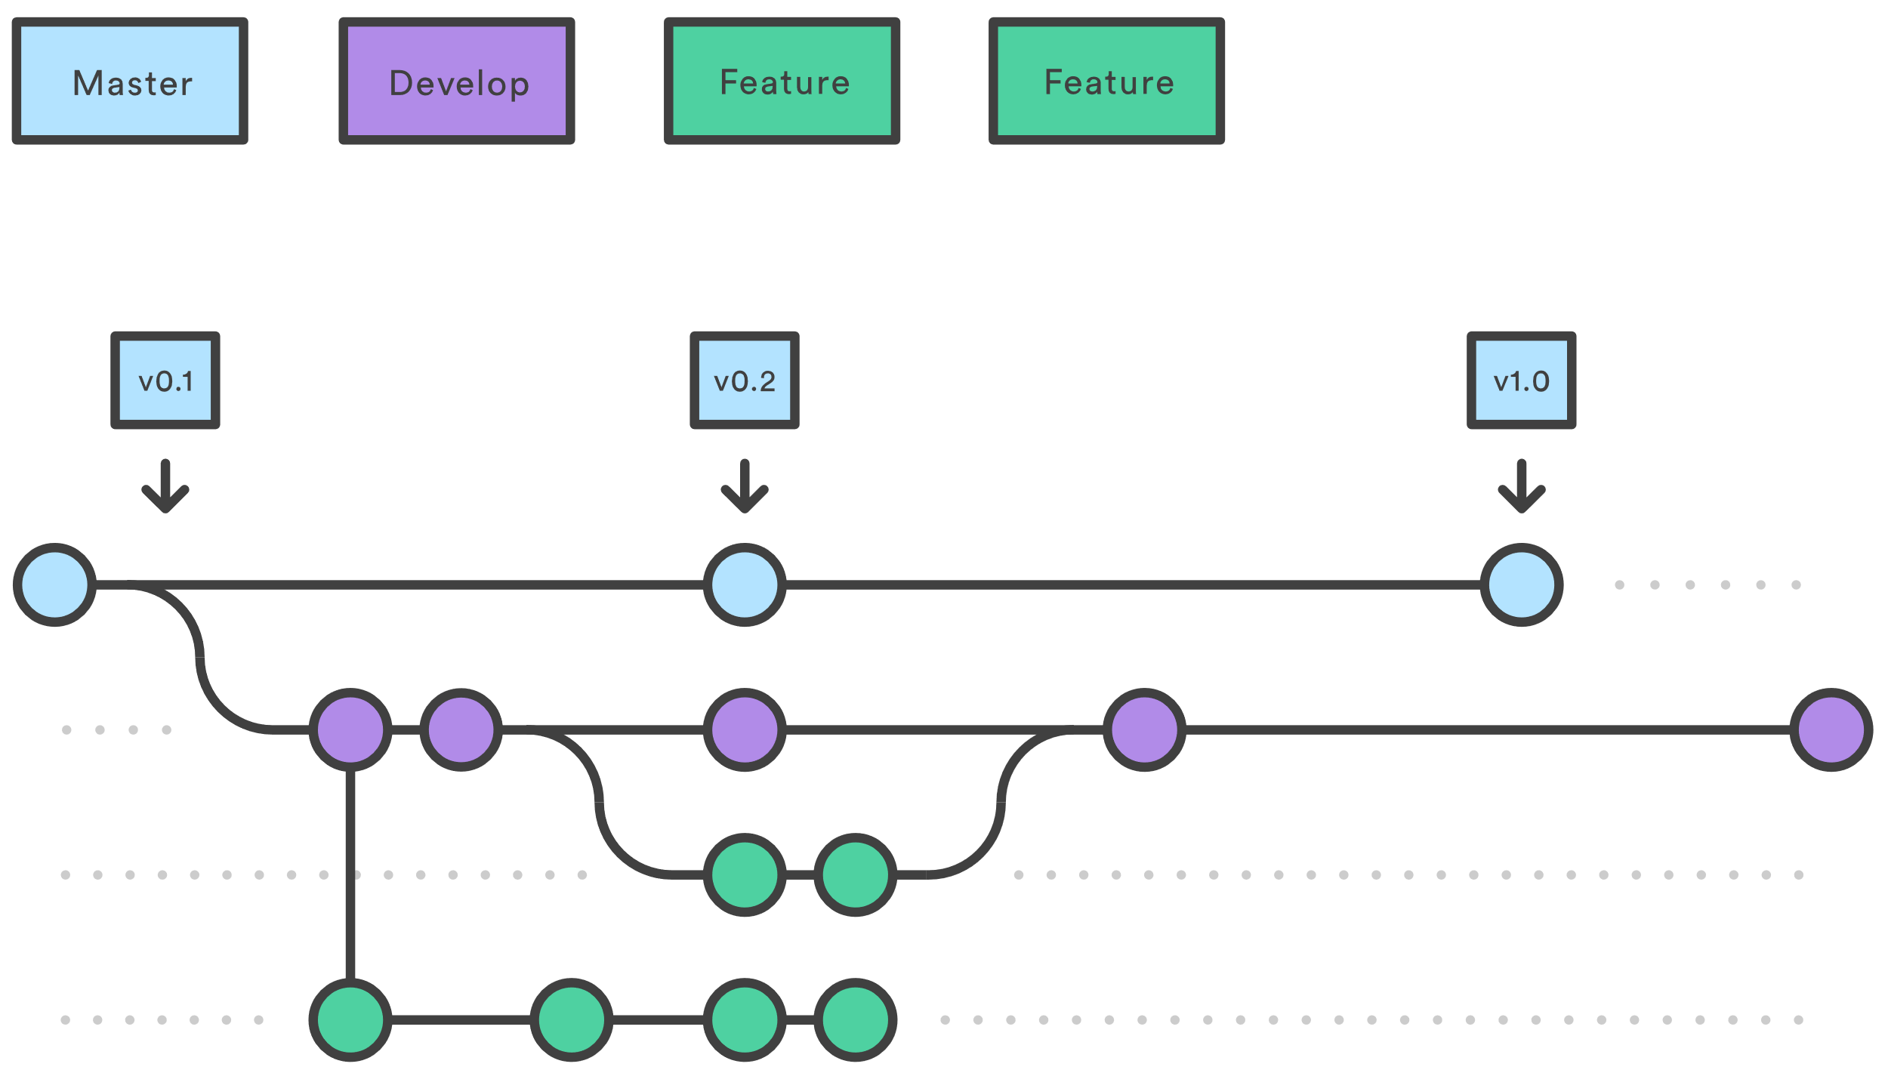
Git Branches: Feature Branches

Slide 21
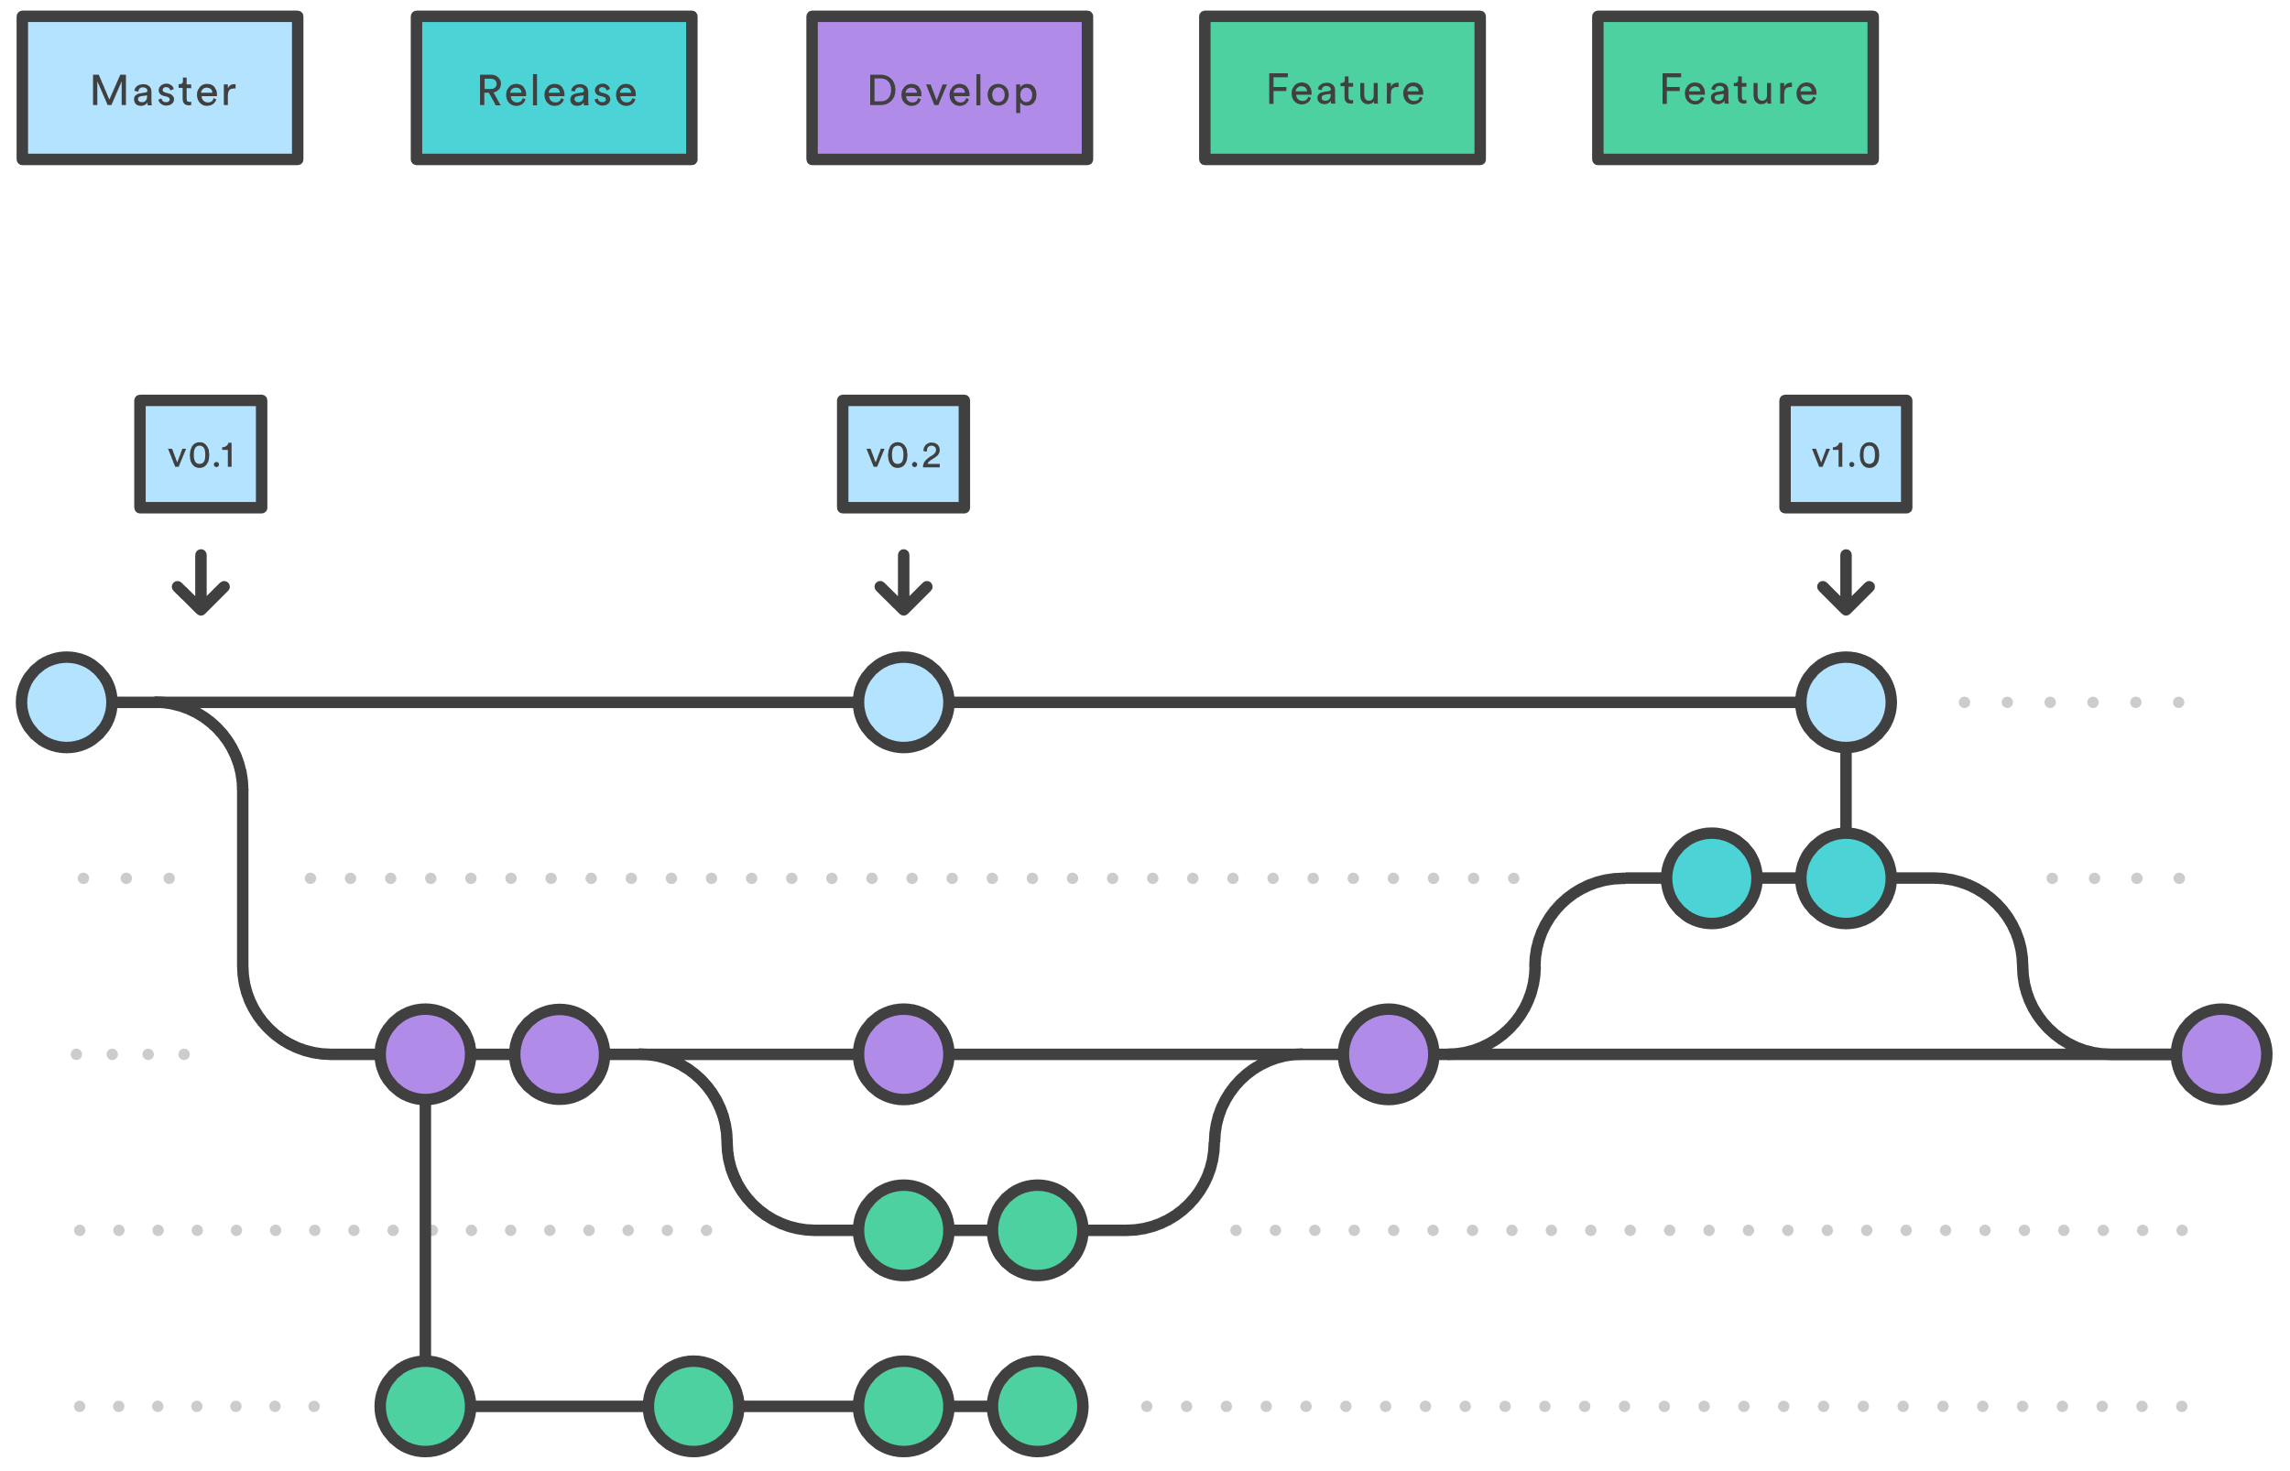
Git Branches: Release Branches

Slide 22
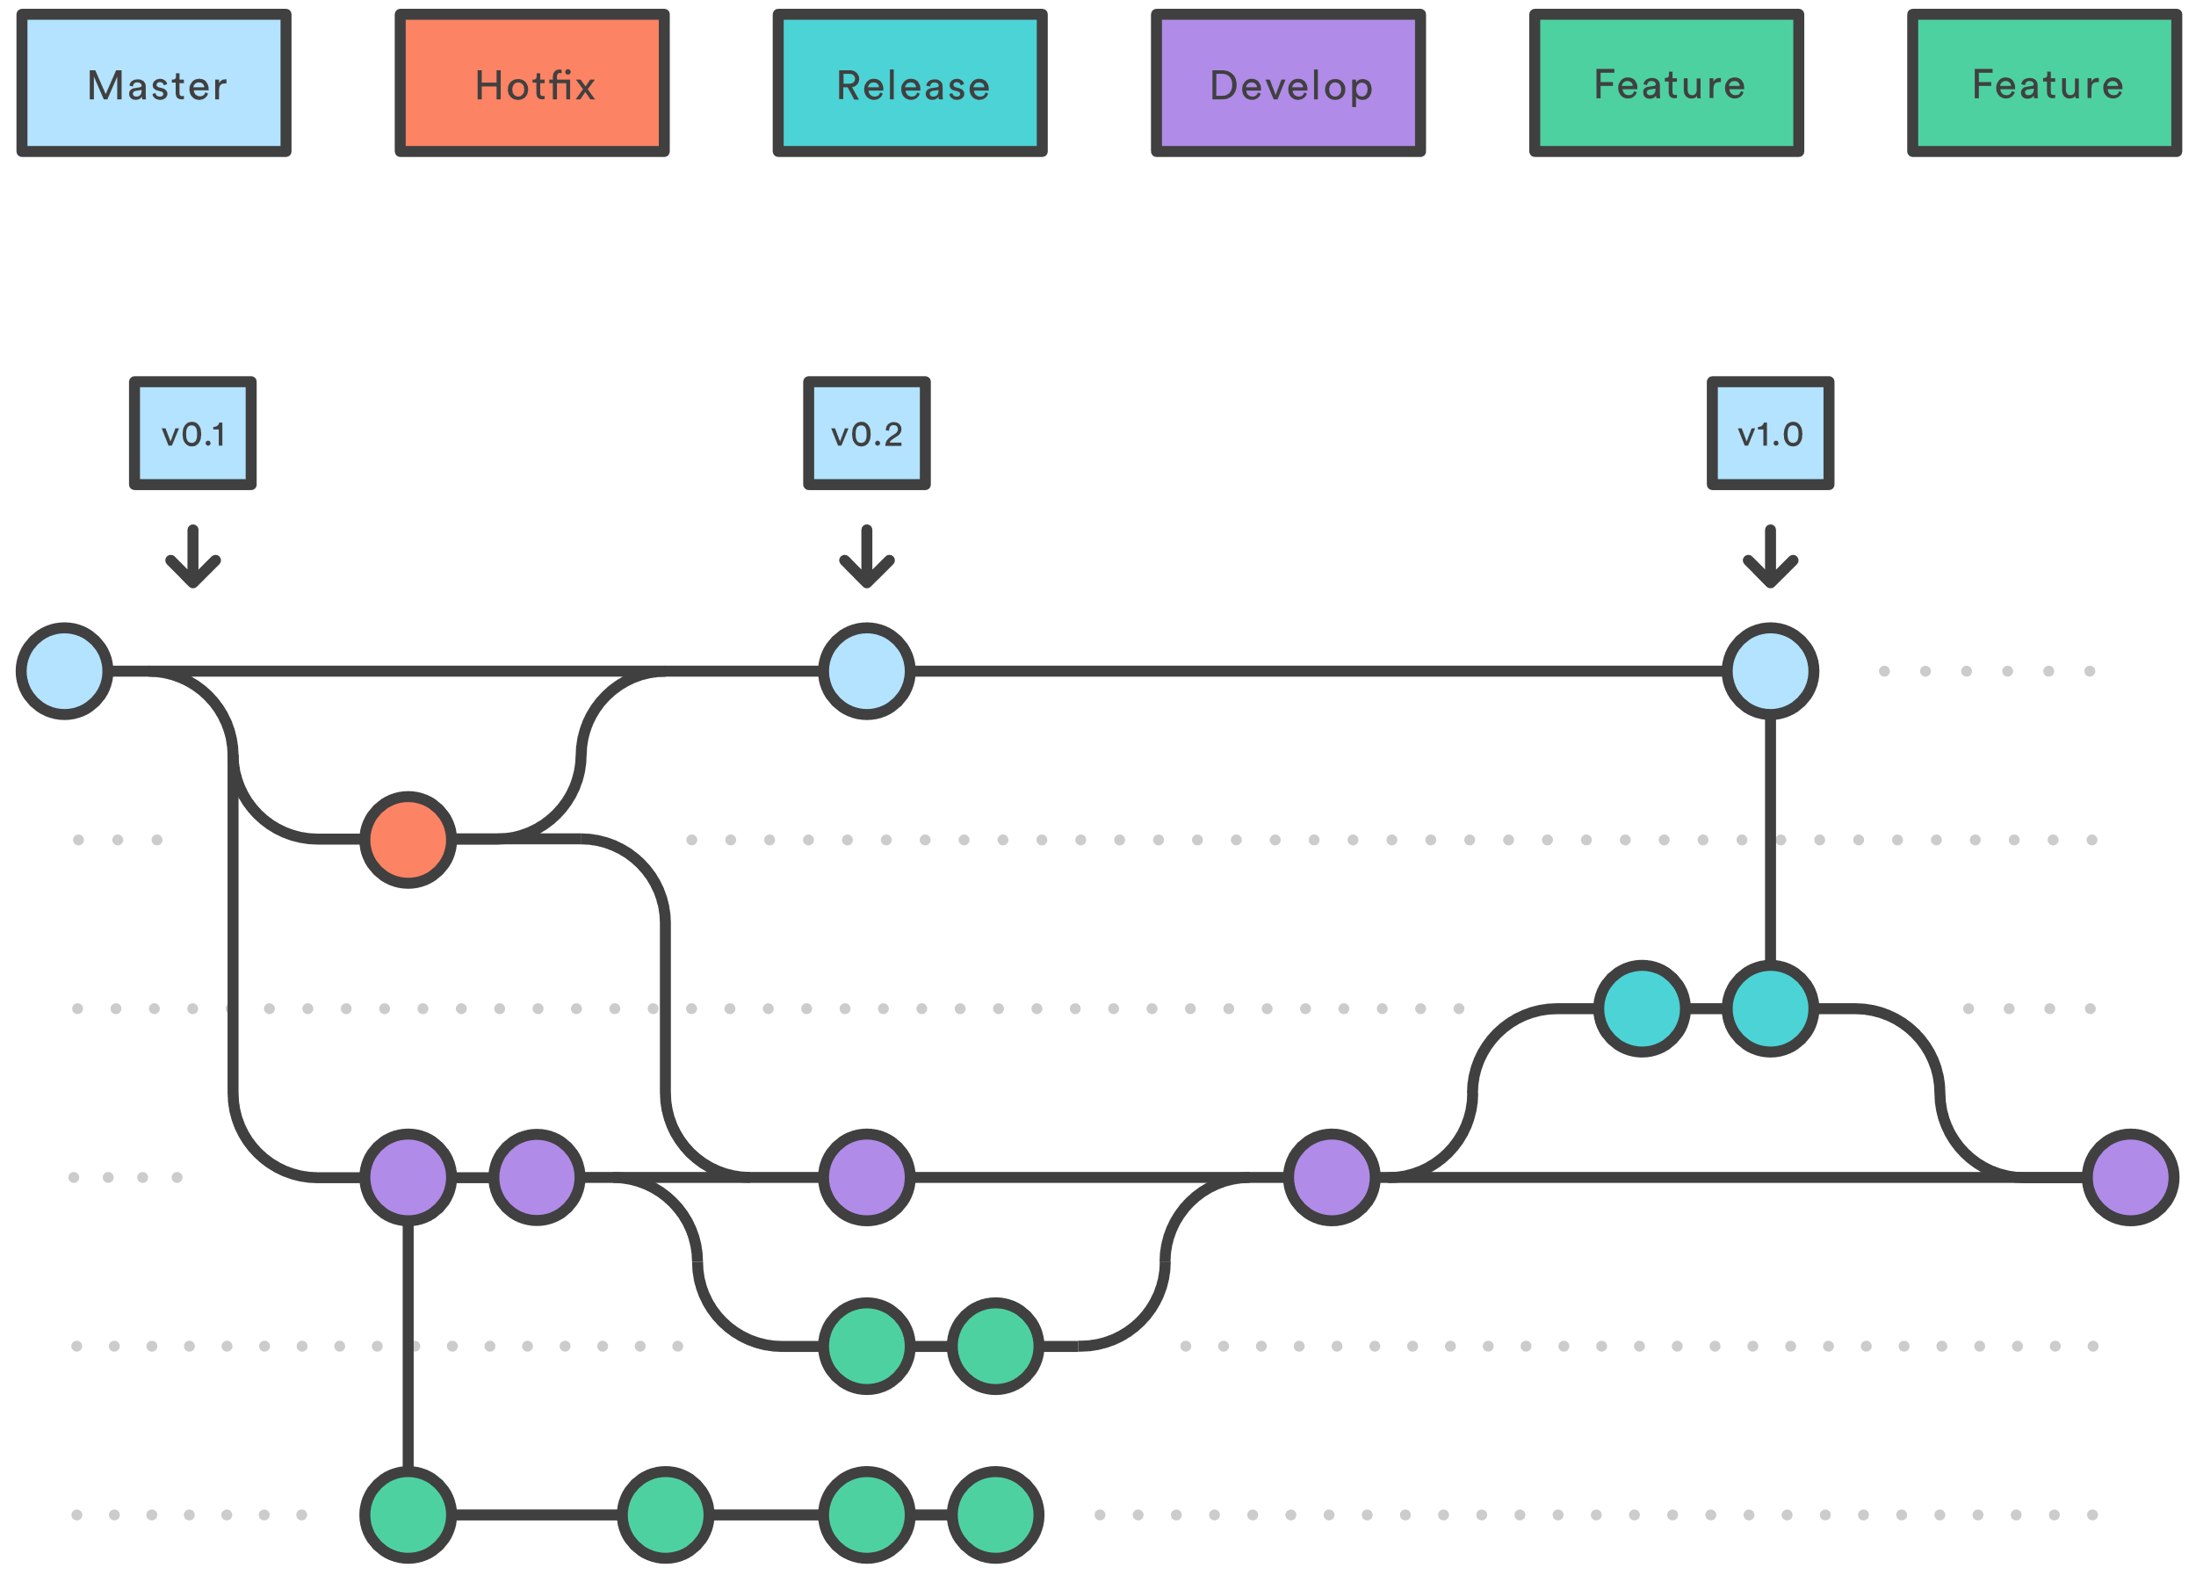
Git Branches: Hotfix Branches

Slide 23
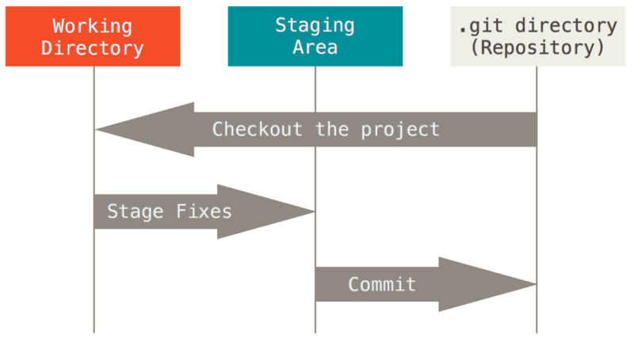
The Staging Area
https://git-scm.com/book/en/v2/Getting-Started-What-is-Git%3F

Slide 24
Git Terminology: the repo
Project: the thing you are working on
Repository or repo: folder/database containing all files/versions
Remote: server hosting a repo of the same project
Cloning: creating a local copy of a remote repository
Forking: creating a remote copy of a remote repository
https://silke.utwente.io/git_course/beginners.html#13

Slide 25
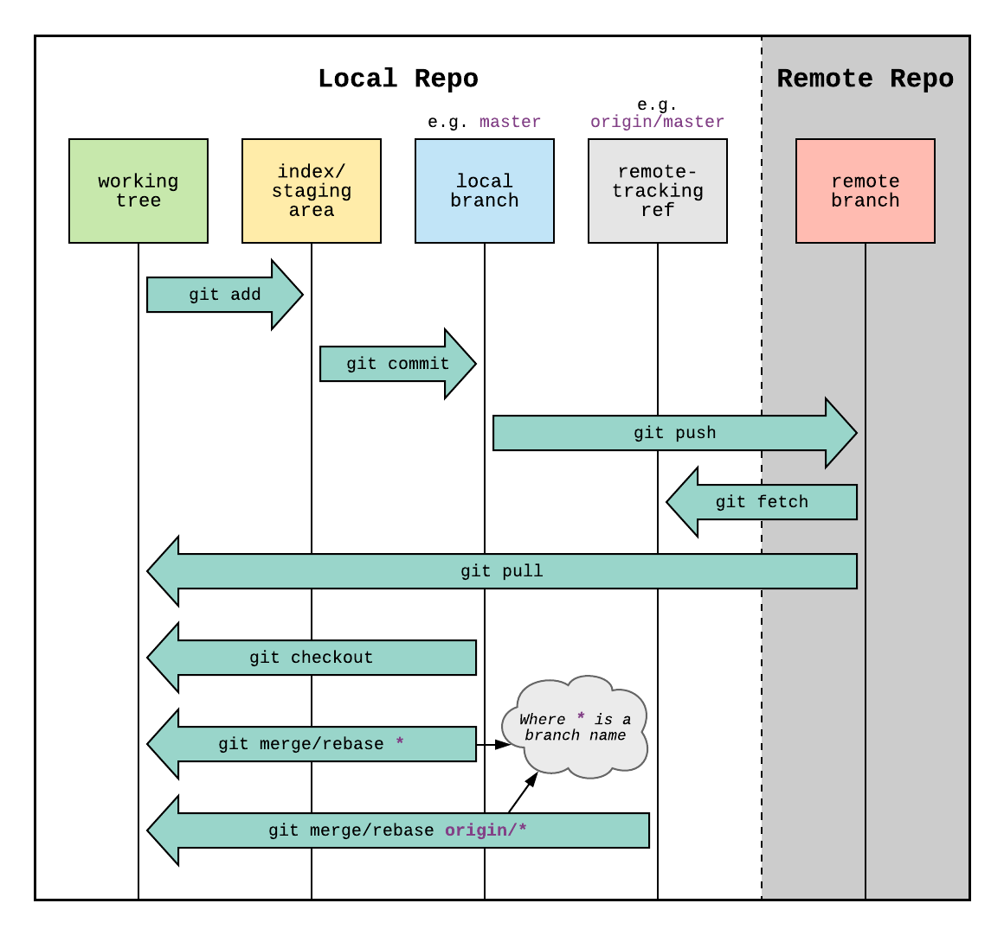
Git Terminology: overview
https://silke.utwente.io/git_course/beginners.html#13

Slide 26

Git command line

Slide 27

Introduction to GitHub
Git workflow for team collaboration

Slide 28
Git workflow for team collaboration
4
Use GitHub to create pull request
GitHub - Original
GitHub - Fork
Version Data Base
Version Data Base
V1
V1
5
Use GitHub to review
and merge pull request
V2
V2
V3
V3
Upstream
Origin
3
git push origin <branch>
Local Machine
Version Data Base
1
git pull upstream master
V1
2
git checkout –b <branch>
git push origin master
V2
git add .
V3
git commit -m “….”
Master(main)

Slide 29
Git workflow rules for team
1. upstream/master == origin/master == local/master: commit ทั้งสามที่ต้องเท่ากันก่อนเริ่มทำงาน
2. Don’t develop in local/master -> create branch for develop in local/feature_branch
3. git pull upstream master มาที่ local/master และเอาไป rebase local/feature_branch
(ทำให้ local/feature_branch มี commit มากกว่า upstream/master แค่ 1 commit)
4. git push origin feature_branch
6. ไปที่ GitHub แล้วทำ pull request จาก origin/feature_branch มาที่ upstream/master
7. code commit มันจะวนจาก local ไป origin ไป upstream วนลงมา local แล้ววนขวาไป

